Slide 1
Unteach Racism webinar series 1.0
Notes:
Welcome to our first Unteach Racism webinar.
This webinar is designed to support kaiako to know more about Unteach Racism, how it came about, and what is included in the resource kete.
It will also help you and your setting to start the Unteach Racism journey.

Slide 2
Notes:
Hear what it means to ‘Unteach Racism’ from Teaching Council Chief Executive | Tāhūhū Rangapū Lesley Hoskin.

Slide 3
Nau mai, haere mai
Ruia taitea, ruia taitea,
kia tū ko taikākā anake.
If you shake away the sapwood, then the heartwood remains.
Notes:
Ruia taitea, ruia taitea kia tū ko taikākā anake.
If you shake away the sapwood, then the heartwood remains.
The first iteration of Unteach Racism went live on Thursday 13 May, 2021. We acknowledge that the process of identifying, confronting and dismantling racism can feel uncomfortable and expose some vulnerabilities, but we believe that this process will also expose the heartwood – the strength, the rigour and our heart for the tamariki under our care.

Slide 4
Objective of Unteach Racism:
Equip teachers with tools to identify, confront and dismantle bias and prejudice so that education is free from racism.
Notes:
The purpose of Unteach Racism is to empower the profession to have safe and productive conversations about racism that result in greater understanding and practice as set out in Our Code, Our Standards | Ngā Tikanga Matatika Ngā Paerewa.
To achieve this purpose, we will equip teachers with tools to identify, confront, and dismantle bias and prejudice. Our goal is an education system that is free from racism.

Slide 5
Partner agencies/expert thought leaders:
Other agencies contributing
to this mahi:
Notes:
We have partnered with the NZ Human Rights Commission, who launched the first nationwide anti-racism campaign in 2017 called ‘Give Nothing to Racism’.
We also acknowledge the support in this kaupapa since 2018 by our expert thought leader group, which included the voices of teachers, principals and children, along with a range of agencies who share the aspiration to dismantle racism in Aotearoa New Zealand. We are not the experts, but have engaged with experts, to ensure that the project is informed by best practice.
In April 2019, the Teaching Council’s Governing Board approved ‘Unteach Racism’ in education as the core concept for the initiative, which raises the status of resisting racism in education, making it a desirable and necessary movement to belong to.

Slide 6
I sense stereotypes in my teacher’s eyes and gestures and how they act towards me makes me feel like leaving.
Secondary school student, Samoan
Notes:
In 2018, the New Zealand School Trustees Association and The Office of the Children’s Commissioner published Education Matters to Me, a collection of reports about how children and young people experience school and what could be improved in the education system to help make them experience it more positively.
From their analysis, six key insights were identified, including “People at school are racist towards me”. The learner voice in Education Matters to Me was the impetus for our initiative……
…. such as this quote from a student who participated in the report.
Following this, the Council undertook a literature scan, and themes emerged about the existence of inequitable outcomes for learners, teachers who have lower expectations for Māori learners, and the need for teachers to build their own cultural competency.

Slide 7
Values/Uara
Notes:
The Teaching Council’s kawa and tikanga is evident in Unteach Racism. It lists Whakamana, Manaakitanga, Pono and Whanaungatanga as the uara that underpin all of the Council’s work, including Our Code, Our Standards | Ngā Tikanga Matatika Ngā Paerewa - the backbone of the system put in place to build coherence and promote notions of building partnerships and strengthening the teaching profession.

Slide 8
Our Code | Ngā Tikanga Matatika
Ko te ngākaunui ki te hapori whānui Commitment to society
Ko te ngākaunui ki te umanga whakaakoranga Commitment to the teaching profession
Ko te ngākaunui ki ngā ākonga Commitment to learners
Ko te ngākaunui ki ngā whānau Commitment to families and whānau
Notes:
Unteach Racism is embedded within Our Code | Ngā Tikanga Matatika commitments. It is not something added on top of teacher practice, but rather lifts awareness by placing a lens over the commitments.
The idea of ‘unteaching’ means that teachers and leaders can actively work to reverse the lessons society teaches learners about who is less valued, by learning and reflecting on their practice.
Unteaching Racism acknowledges the unique skills and experience teachers have, and their position of influence and expertise in being able to address this challenge. We know they will inspire others to do the same and therefore it is a powerful call to action.

Slide 9
Feed/Starve
Feed:
Making discriminatory remarks about Māori learners, their whānau and community, or their identity and culture.
Starve:
Articulating and fostering high expectations of Māori learners.
Notes:
The Code of Professional Responsibility: Examples in Practice provides positive examples of behaviours that would starve racism and unacceptable behaviours that would feed it.
Take a moment to reflect on these examples of feeding and starving racism in everyday teacher practice.
Our learning environments can feed or starve racism. The idea of ‘unteaching’ means that teachers and leaders can actively work to reverse the lessons society teaches learners about who is less valued, by learning and reflecting on their practice.

Slide 10
Notes:
Unteach Racism aims to support teachers in a staged approach, to identify, confront and dismantle racism in education. ​This work has been designed specifically for teachers, leveraging your unique skills and opportunities to shape the hearts and minds of children and young people. It is not expected that you will teach students or complete all app modules or resources by a particular time. This is your journey, to do in your own time, at your own pace. It might feel scary or uncomfortable at times, but it is more important than ever to forge ahead. Self-reflection and frank, open conversations grounded in Our Code | Ngā Tikanga Matatika is the first step.

Slide 11
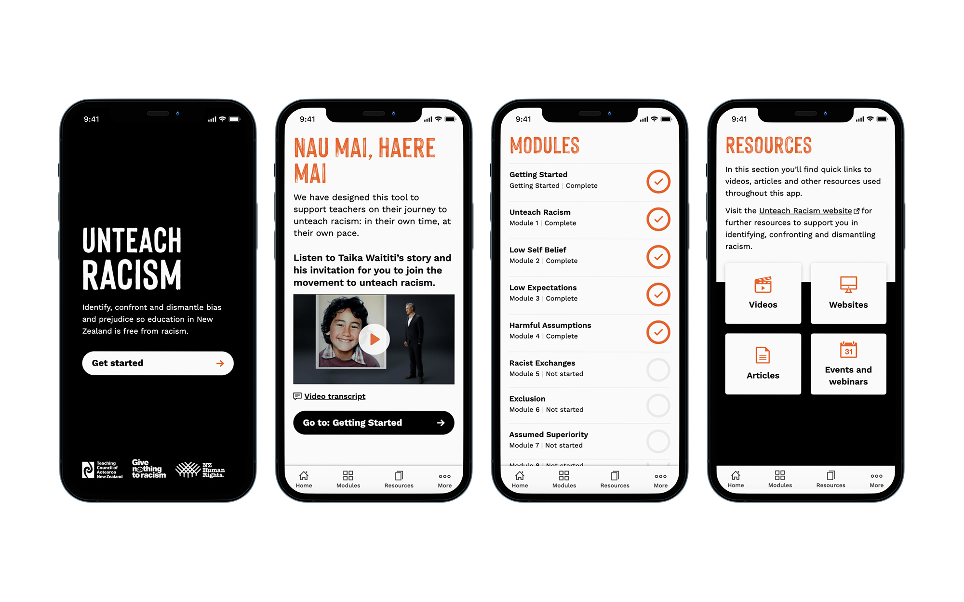
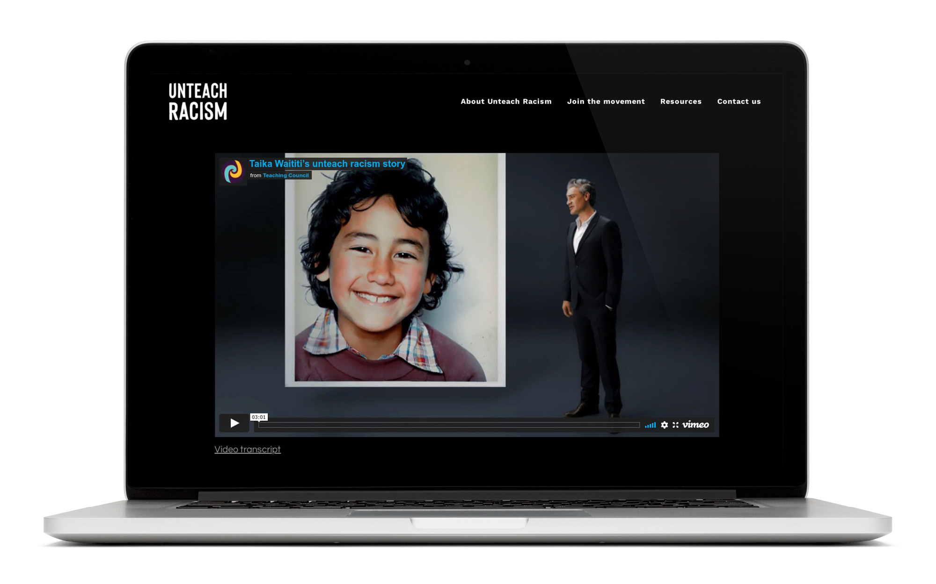
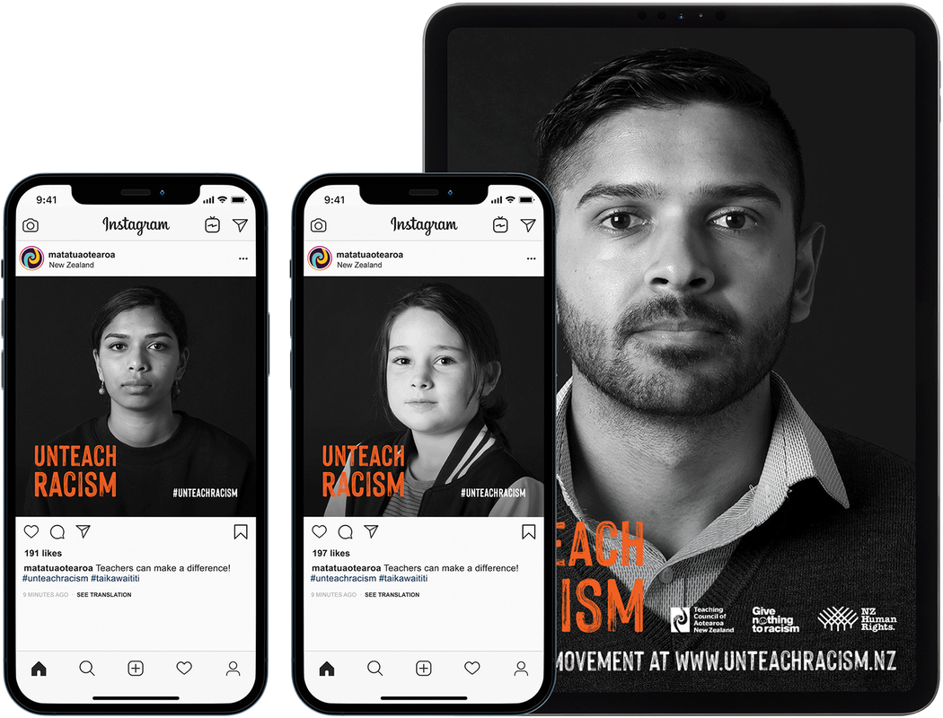
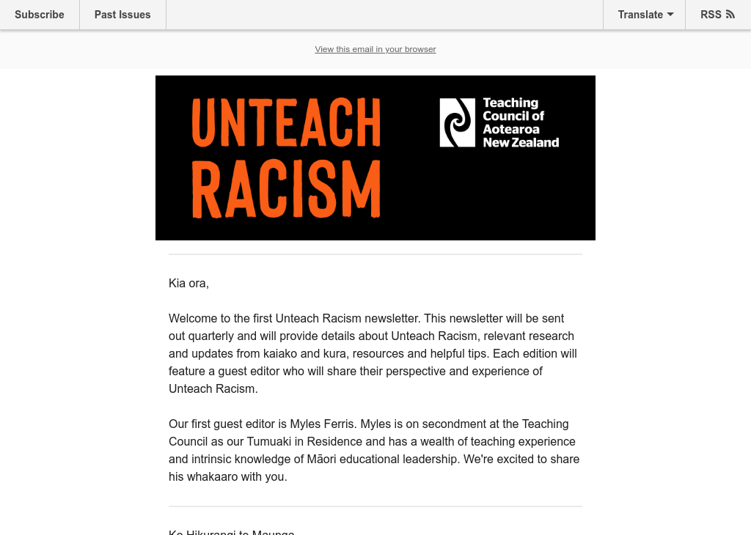
Components of Unteach Racism
App
Website
Hapori Matatū
Toolkit
Newsletter
This PowerPoint
Notes:
The various Unteach Racism components are to support self-reflection and identify where you may need to shift your own understanding of racism, in order to better support all learners to succeed.
We recommend starting with the Unteach Racism app. It has been designed to support you as a teacher on your journey to unteach racism.
The website is the hub of Unteach Racism; you can access the app from the website as well as key resources to use during professional learning, and an opportunity to sign up to our quarterly newsletter.
Hapori Matatū is a place for you to start or join a conversation and connect with other teachers on their Unteach Racism journey.
The Unteach Racism toolkit is available to download posters and social media graphics to support you and your setting to Join the Movement.
Our quarterly newsletter includes a narrative written by a special guest, plus it includes tips and updates on when new resources, including the dismantle phase, become available.

Slide 12
App

Slide 13
Notes:
The app has been designed to use on a device; however, you can also use it on your desktop.

Slide 14
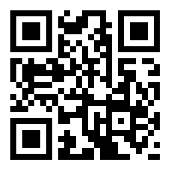
App: Let’s go
Scan the QR code to get started.
Notes:
You can connect to the Unteach Racism app right now by scanning the QR code shown on this slide (simply scan the QR code with the camera on your phone or use a QR scanner app).
Otherwise you can connect to the app from the Unteach Racism website. Once on the website, scan the QR code with your device, or click on the orange ‘Let’s go’ button if you would like to connect using your desktop.

Slide 15
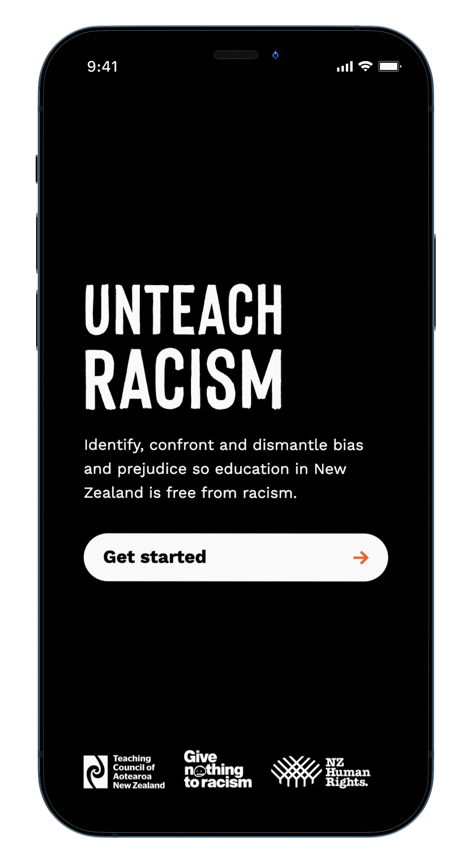
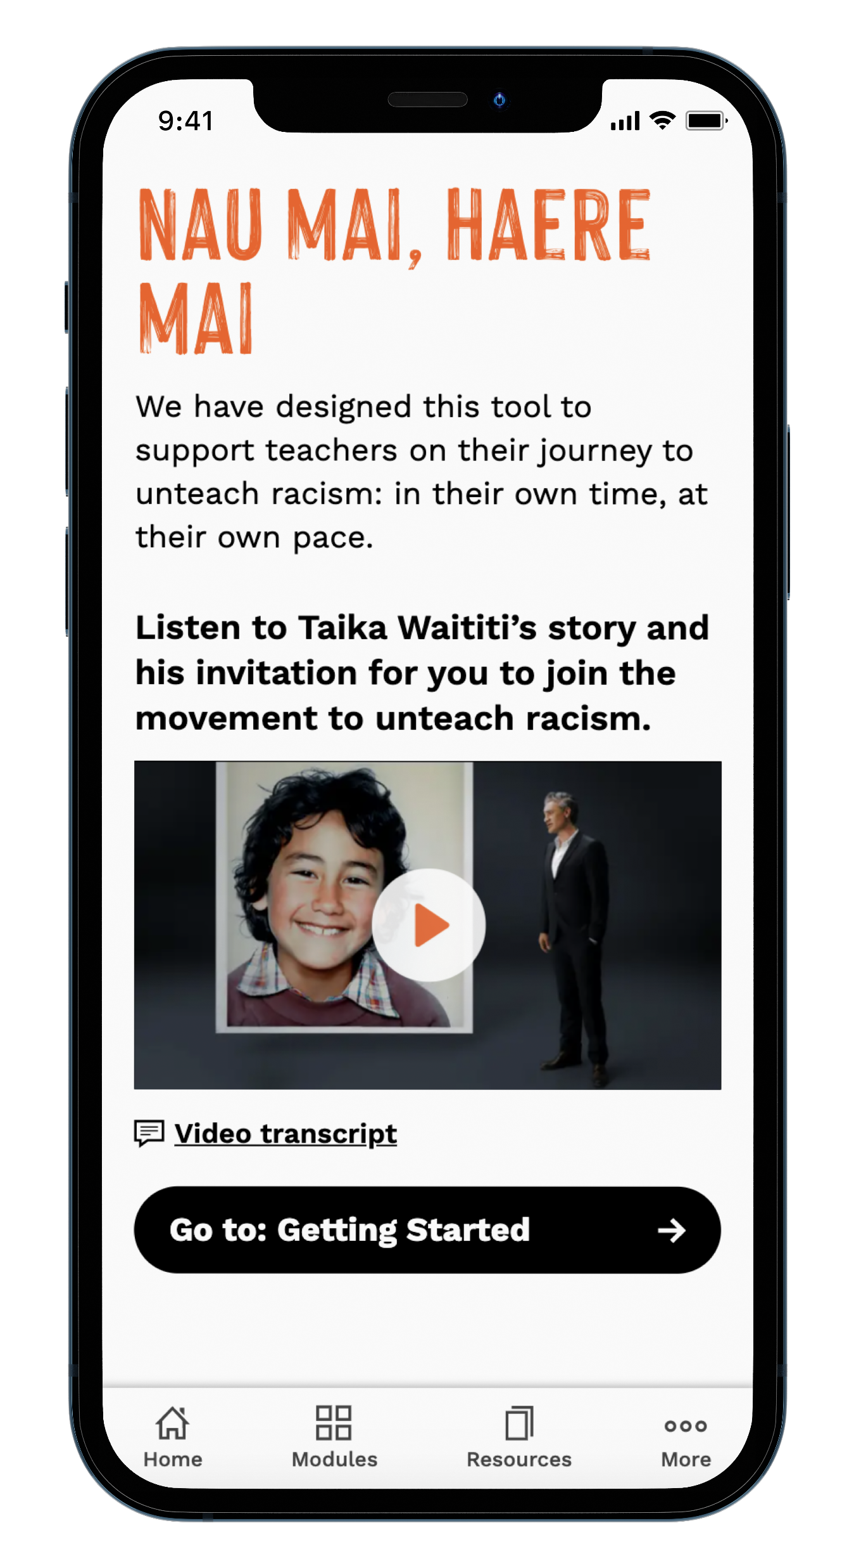
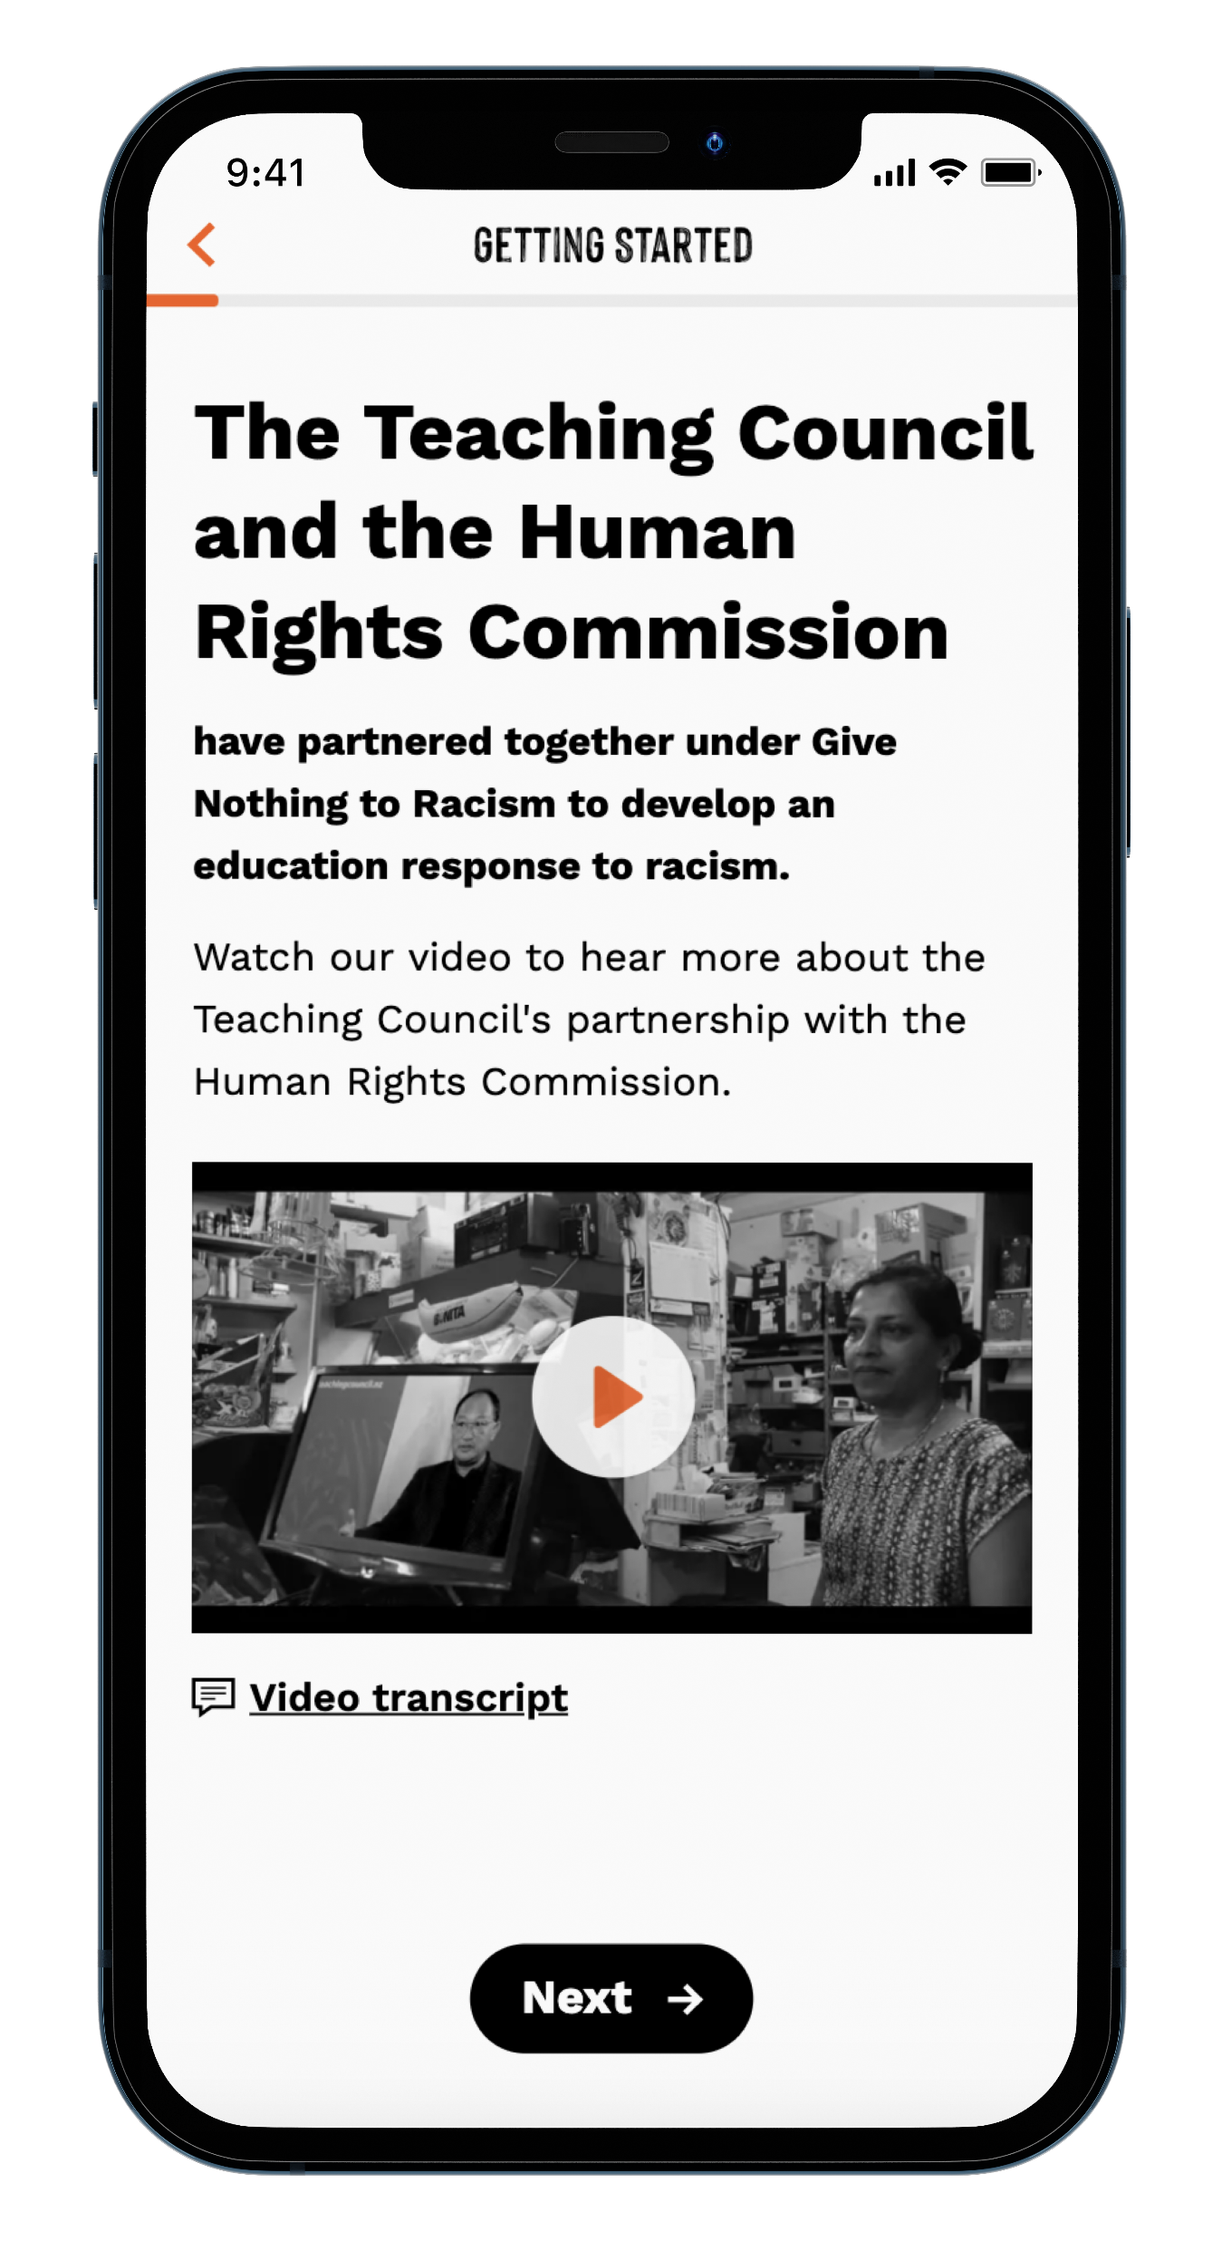
App: Sections
Notes:
As you use the app, you will be prompted to save it so that it is always available on your device.

Slide 16
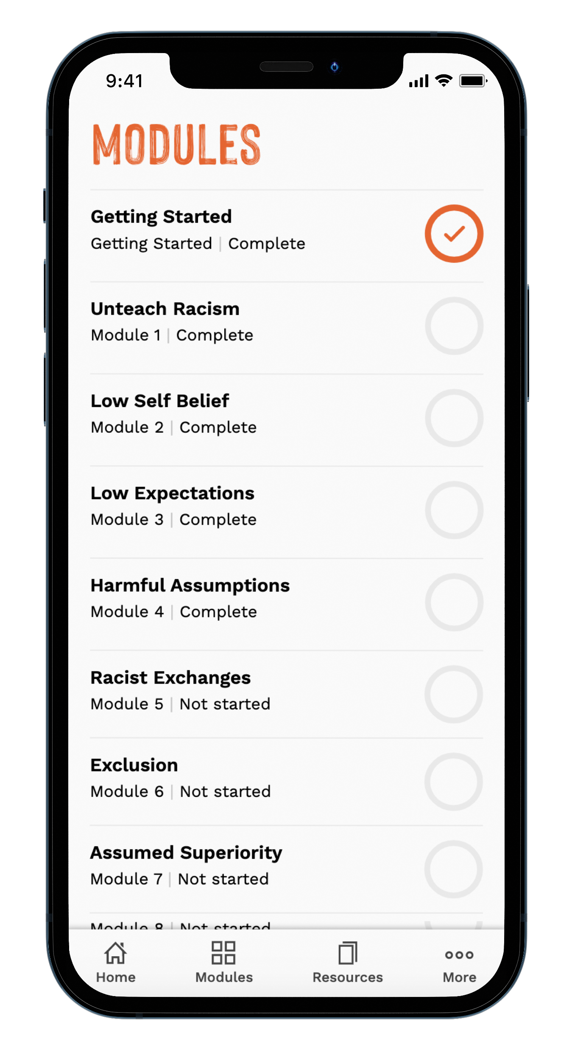
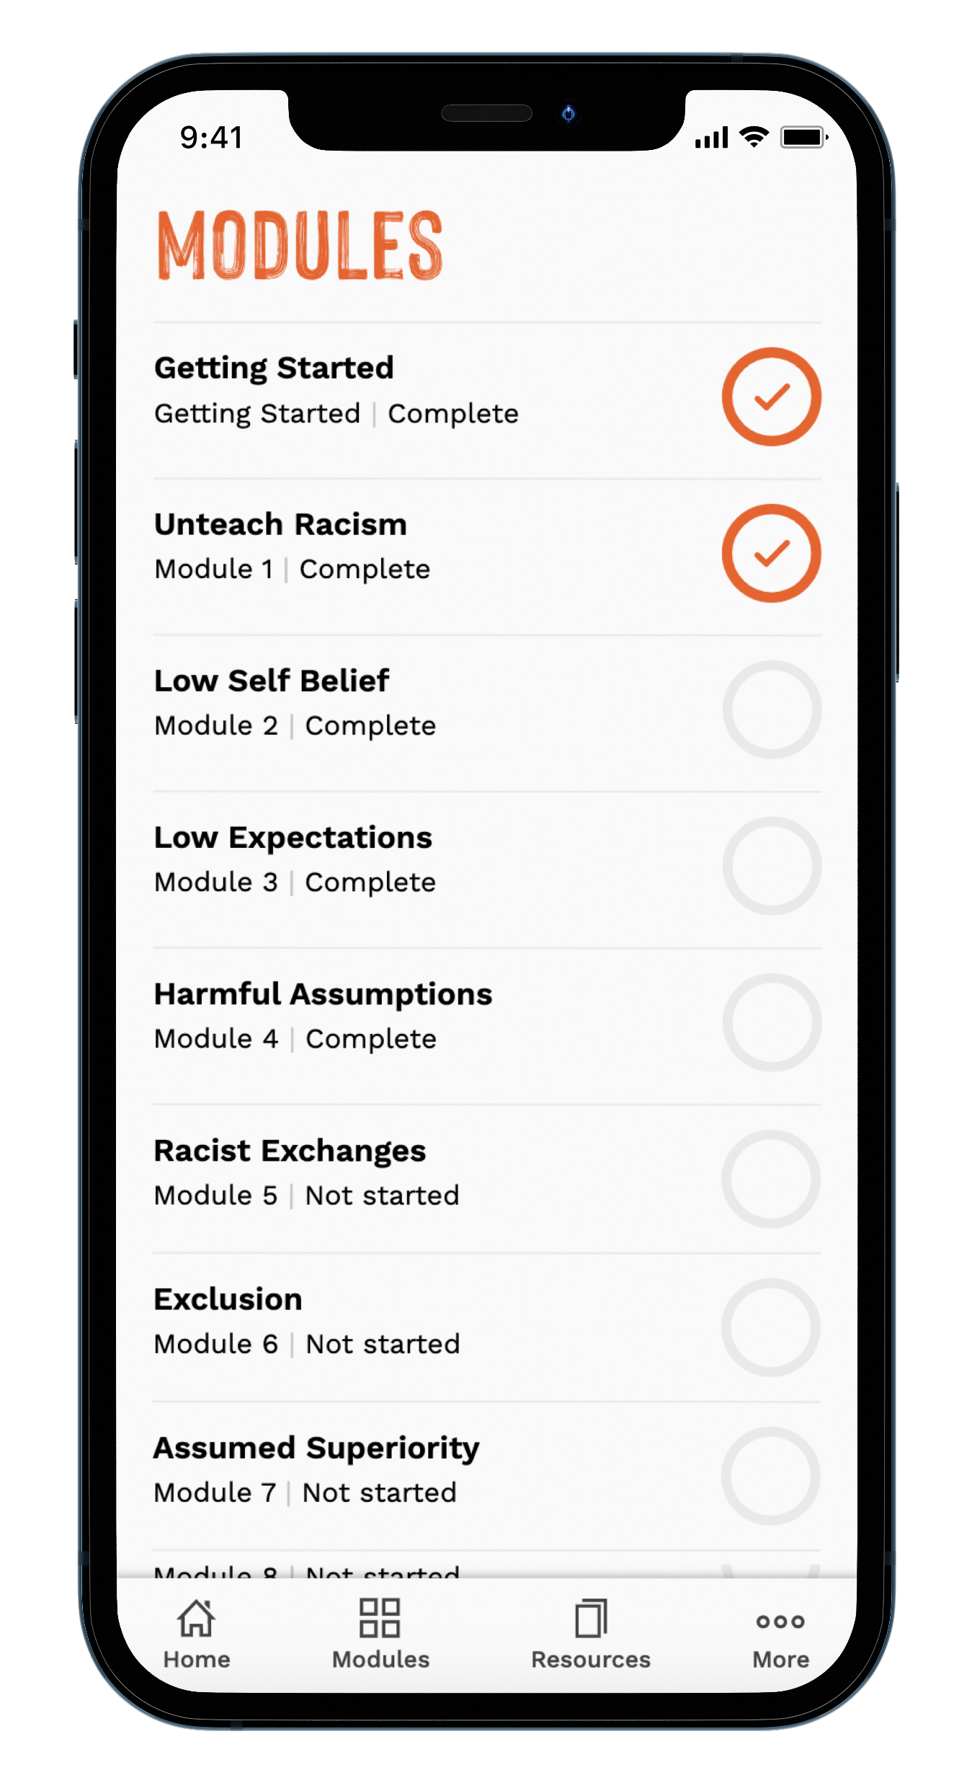
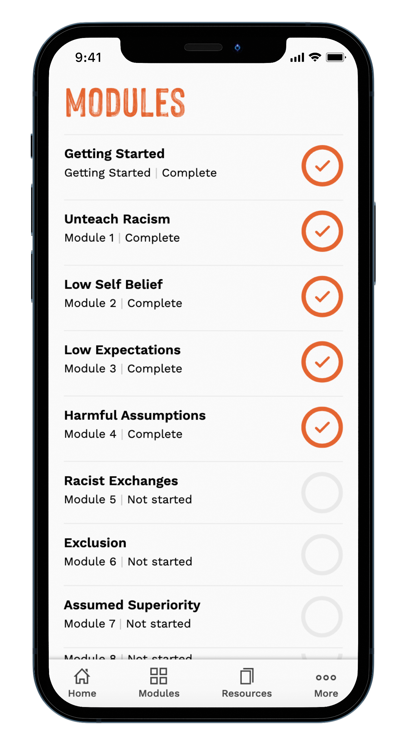
App: Modules
Notes:
The app is made up of eight key modules that sit across identify and confront racism. We really encourage teachers to work through the app as part of their own Unteach Racism journey; each teacher will be at a different stage.
The modules can be done in any order; however, we recommend starting with 1 and working through to 8. Your progress is tracked as a percentage so you can easily view what you have completed.

Slide 17
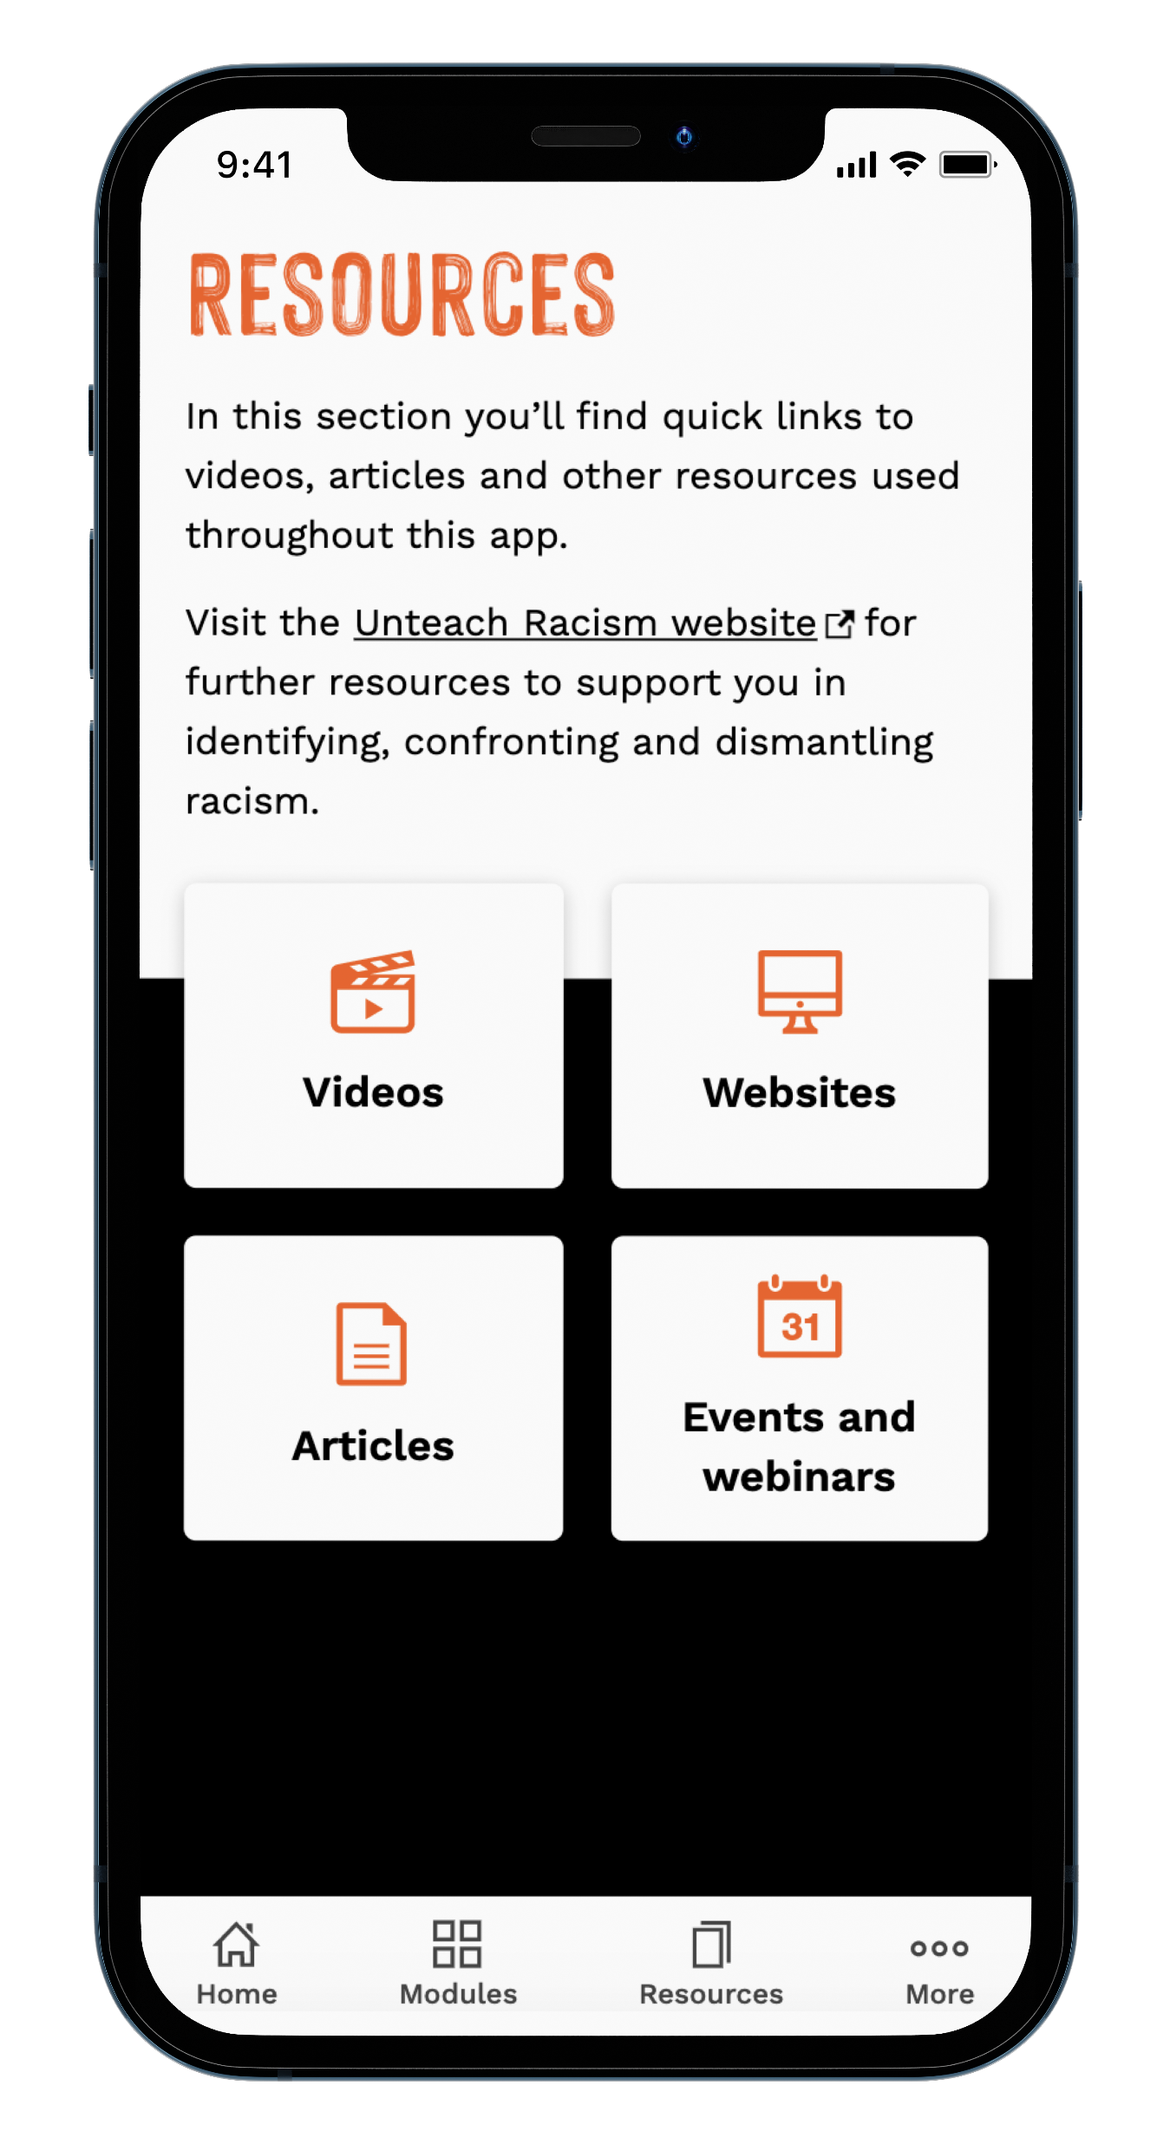
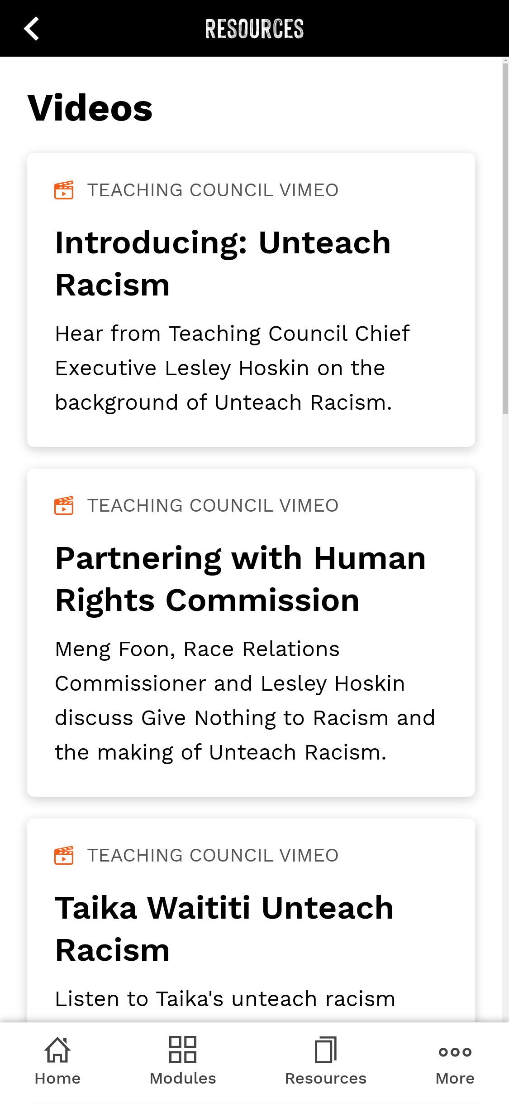
App: Videos
Notes:
Under resources, you’ll find videos that introduce audiences to Unteach Racism. We suggest starting with the Taika Waititi video and then move on to the introduction to Unteach Racism videos featuring Meng Foon, Human Rights Commissioner and Teaching Council Chief Executive | Tāhūhū Rangapū Lesley Hoskin.

Slide 18
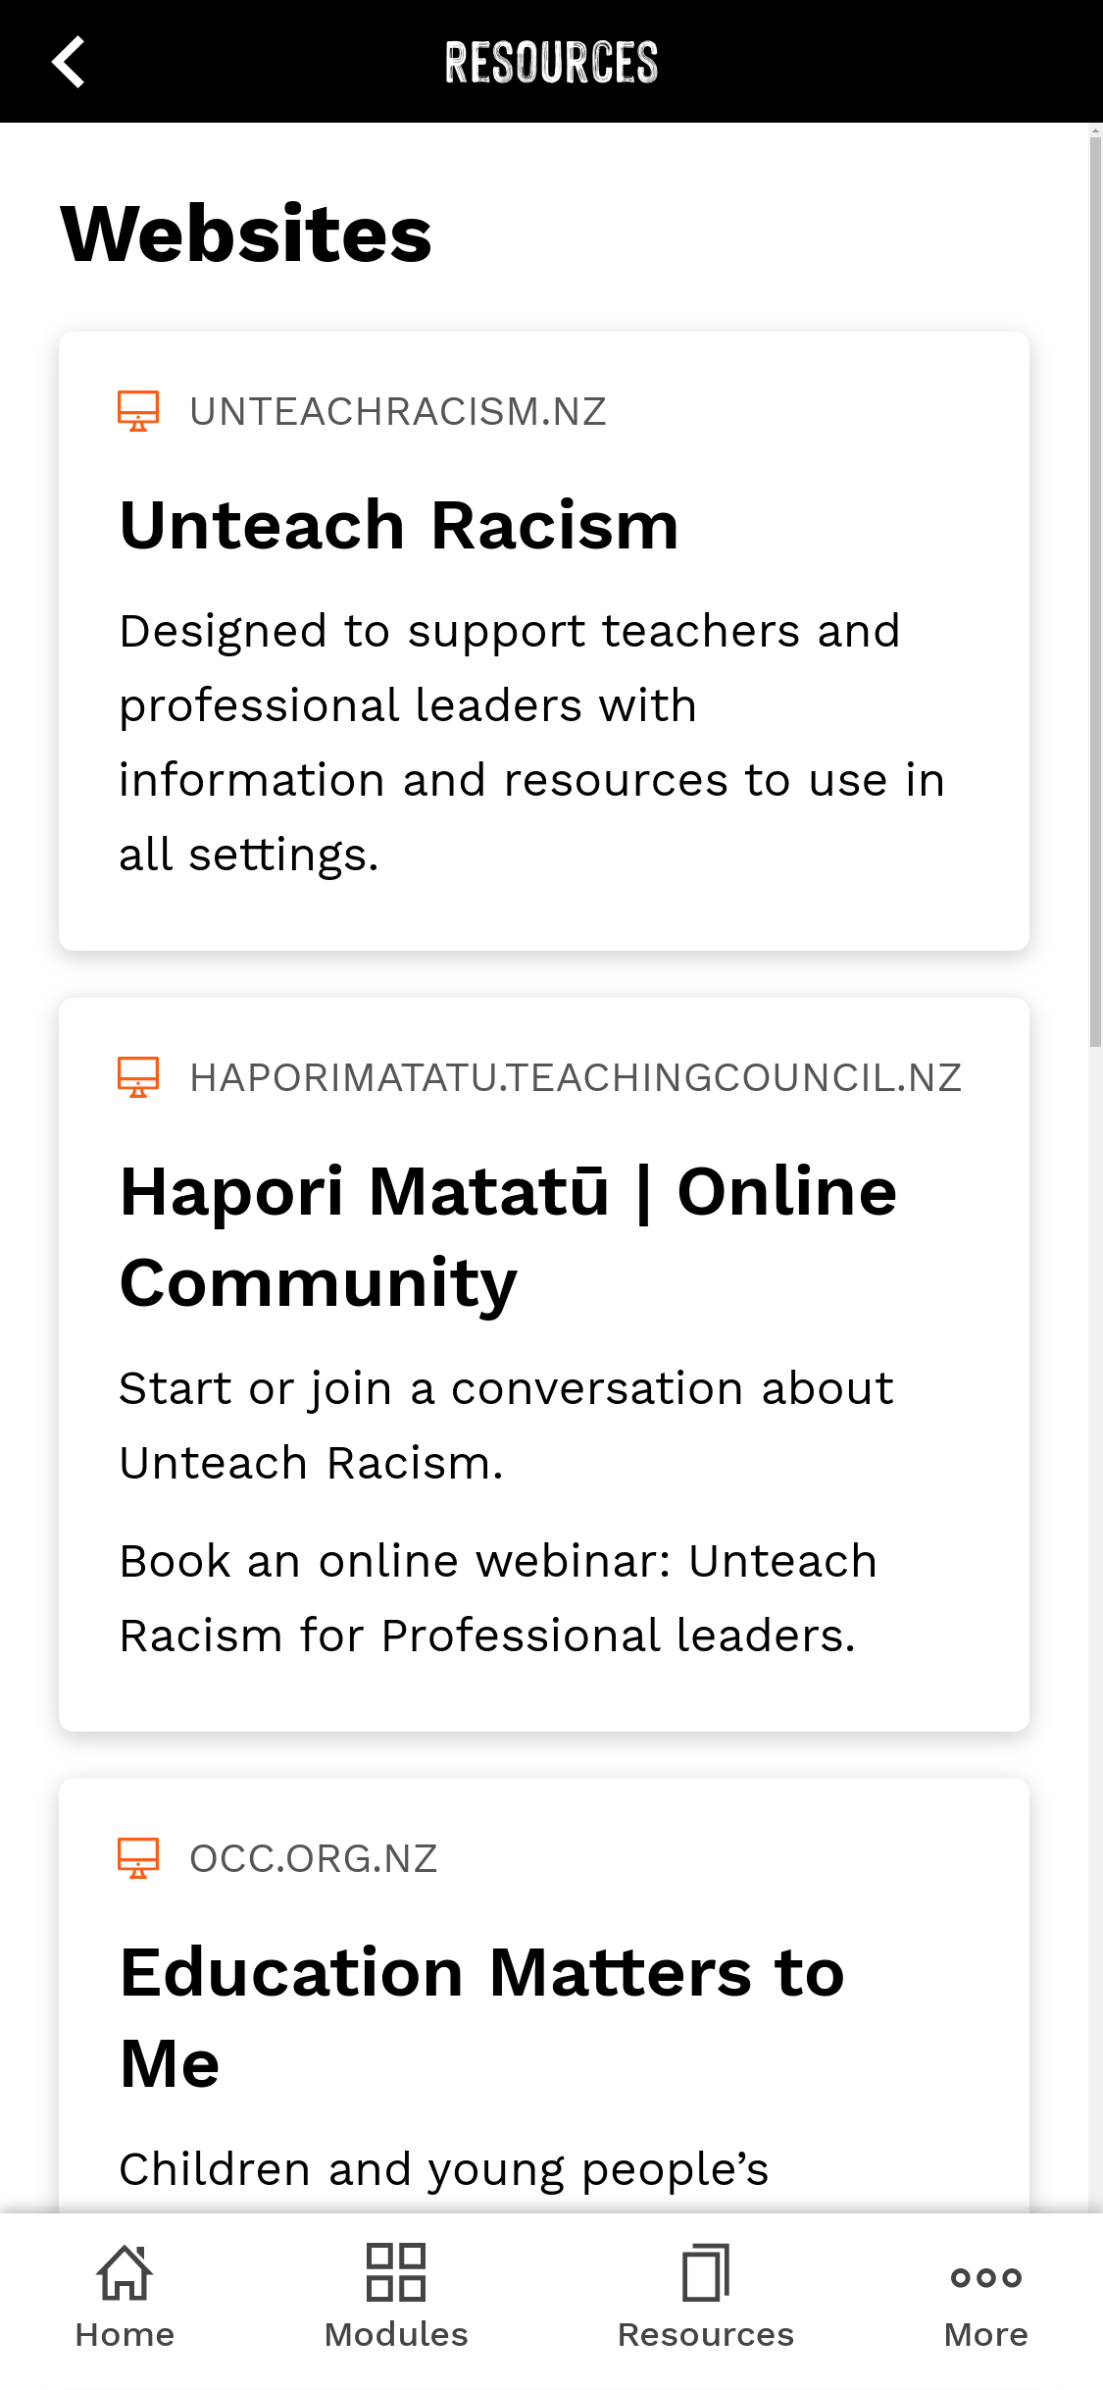
App: Websites
Notes:
Under resources you’ll also find links to websites; for example, the Harvard University Implicit Associations Test is an interactive assessment tool which can help you to reflect on your biases. There are links to websites from most of the modules, and the Implicit Associations Test can also be accessed in Module 4 Harmful Assumptions.

Slide 19
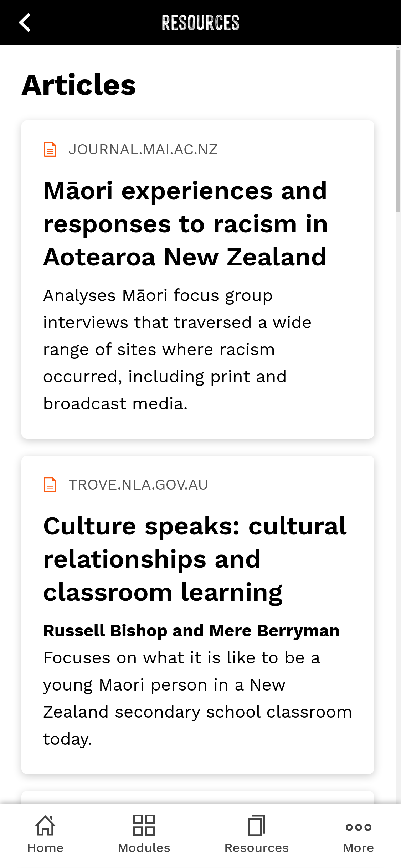
App: Articles
Notes:
We have also included articles under ‘Resources’, and encourage you to read or disseminate; they vary in length and complexity.
We’ll add any upcoming events or webinars in the ‘Events and webinars’ tile, including this pre-recorded webinar.

Slide 20
Website

Slide 21
Notes:
The Unteachracism.nz website is set up so you can easily navigate and find the information you need.
Our story and videos are located under ‘About Unteach Racism’
The toolkit to support you and your setting can be downloaded from ‘Join the Movement’
Our resources are structured to match the modules in the app; have a look through the ‘Resource’ section to see what resources you could start to use now.

Slide 22
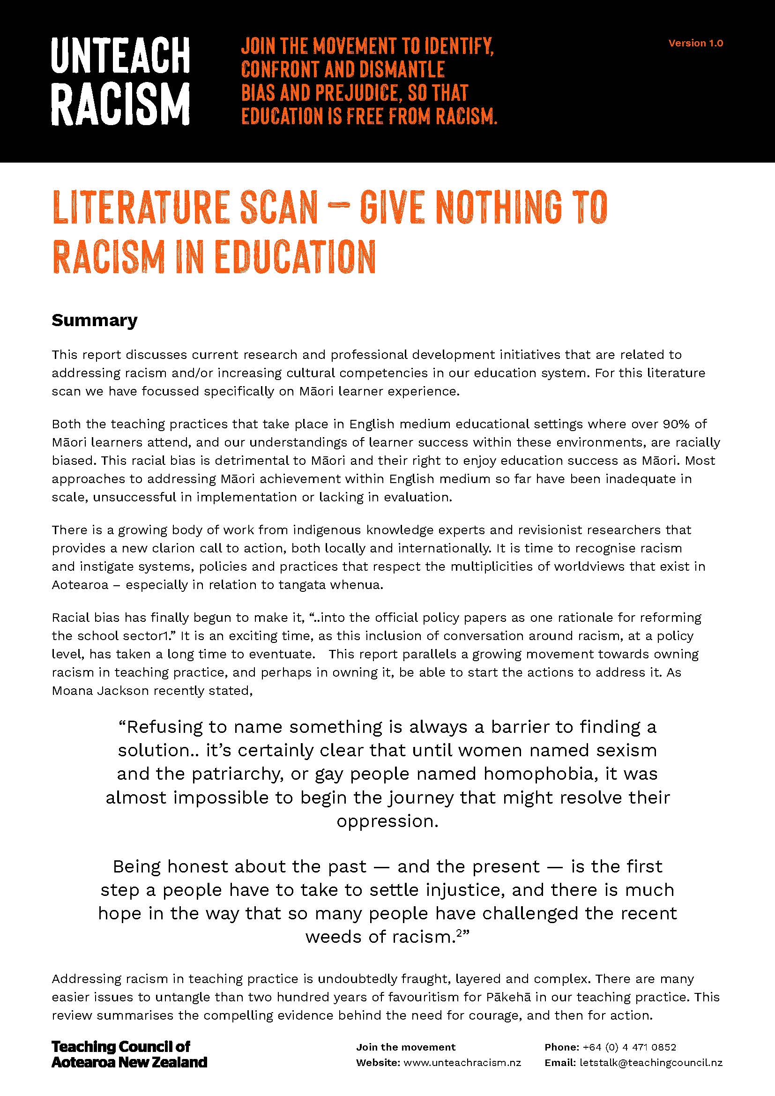
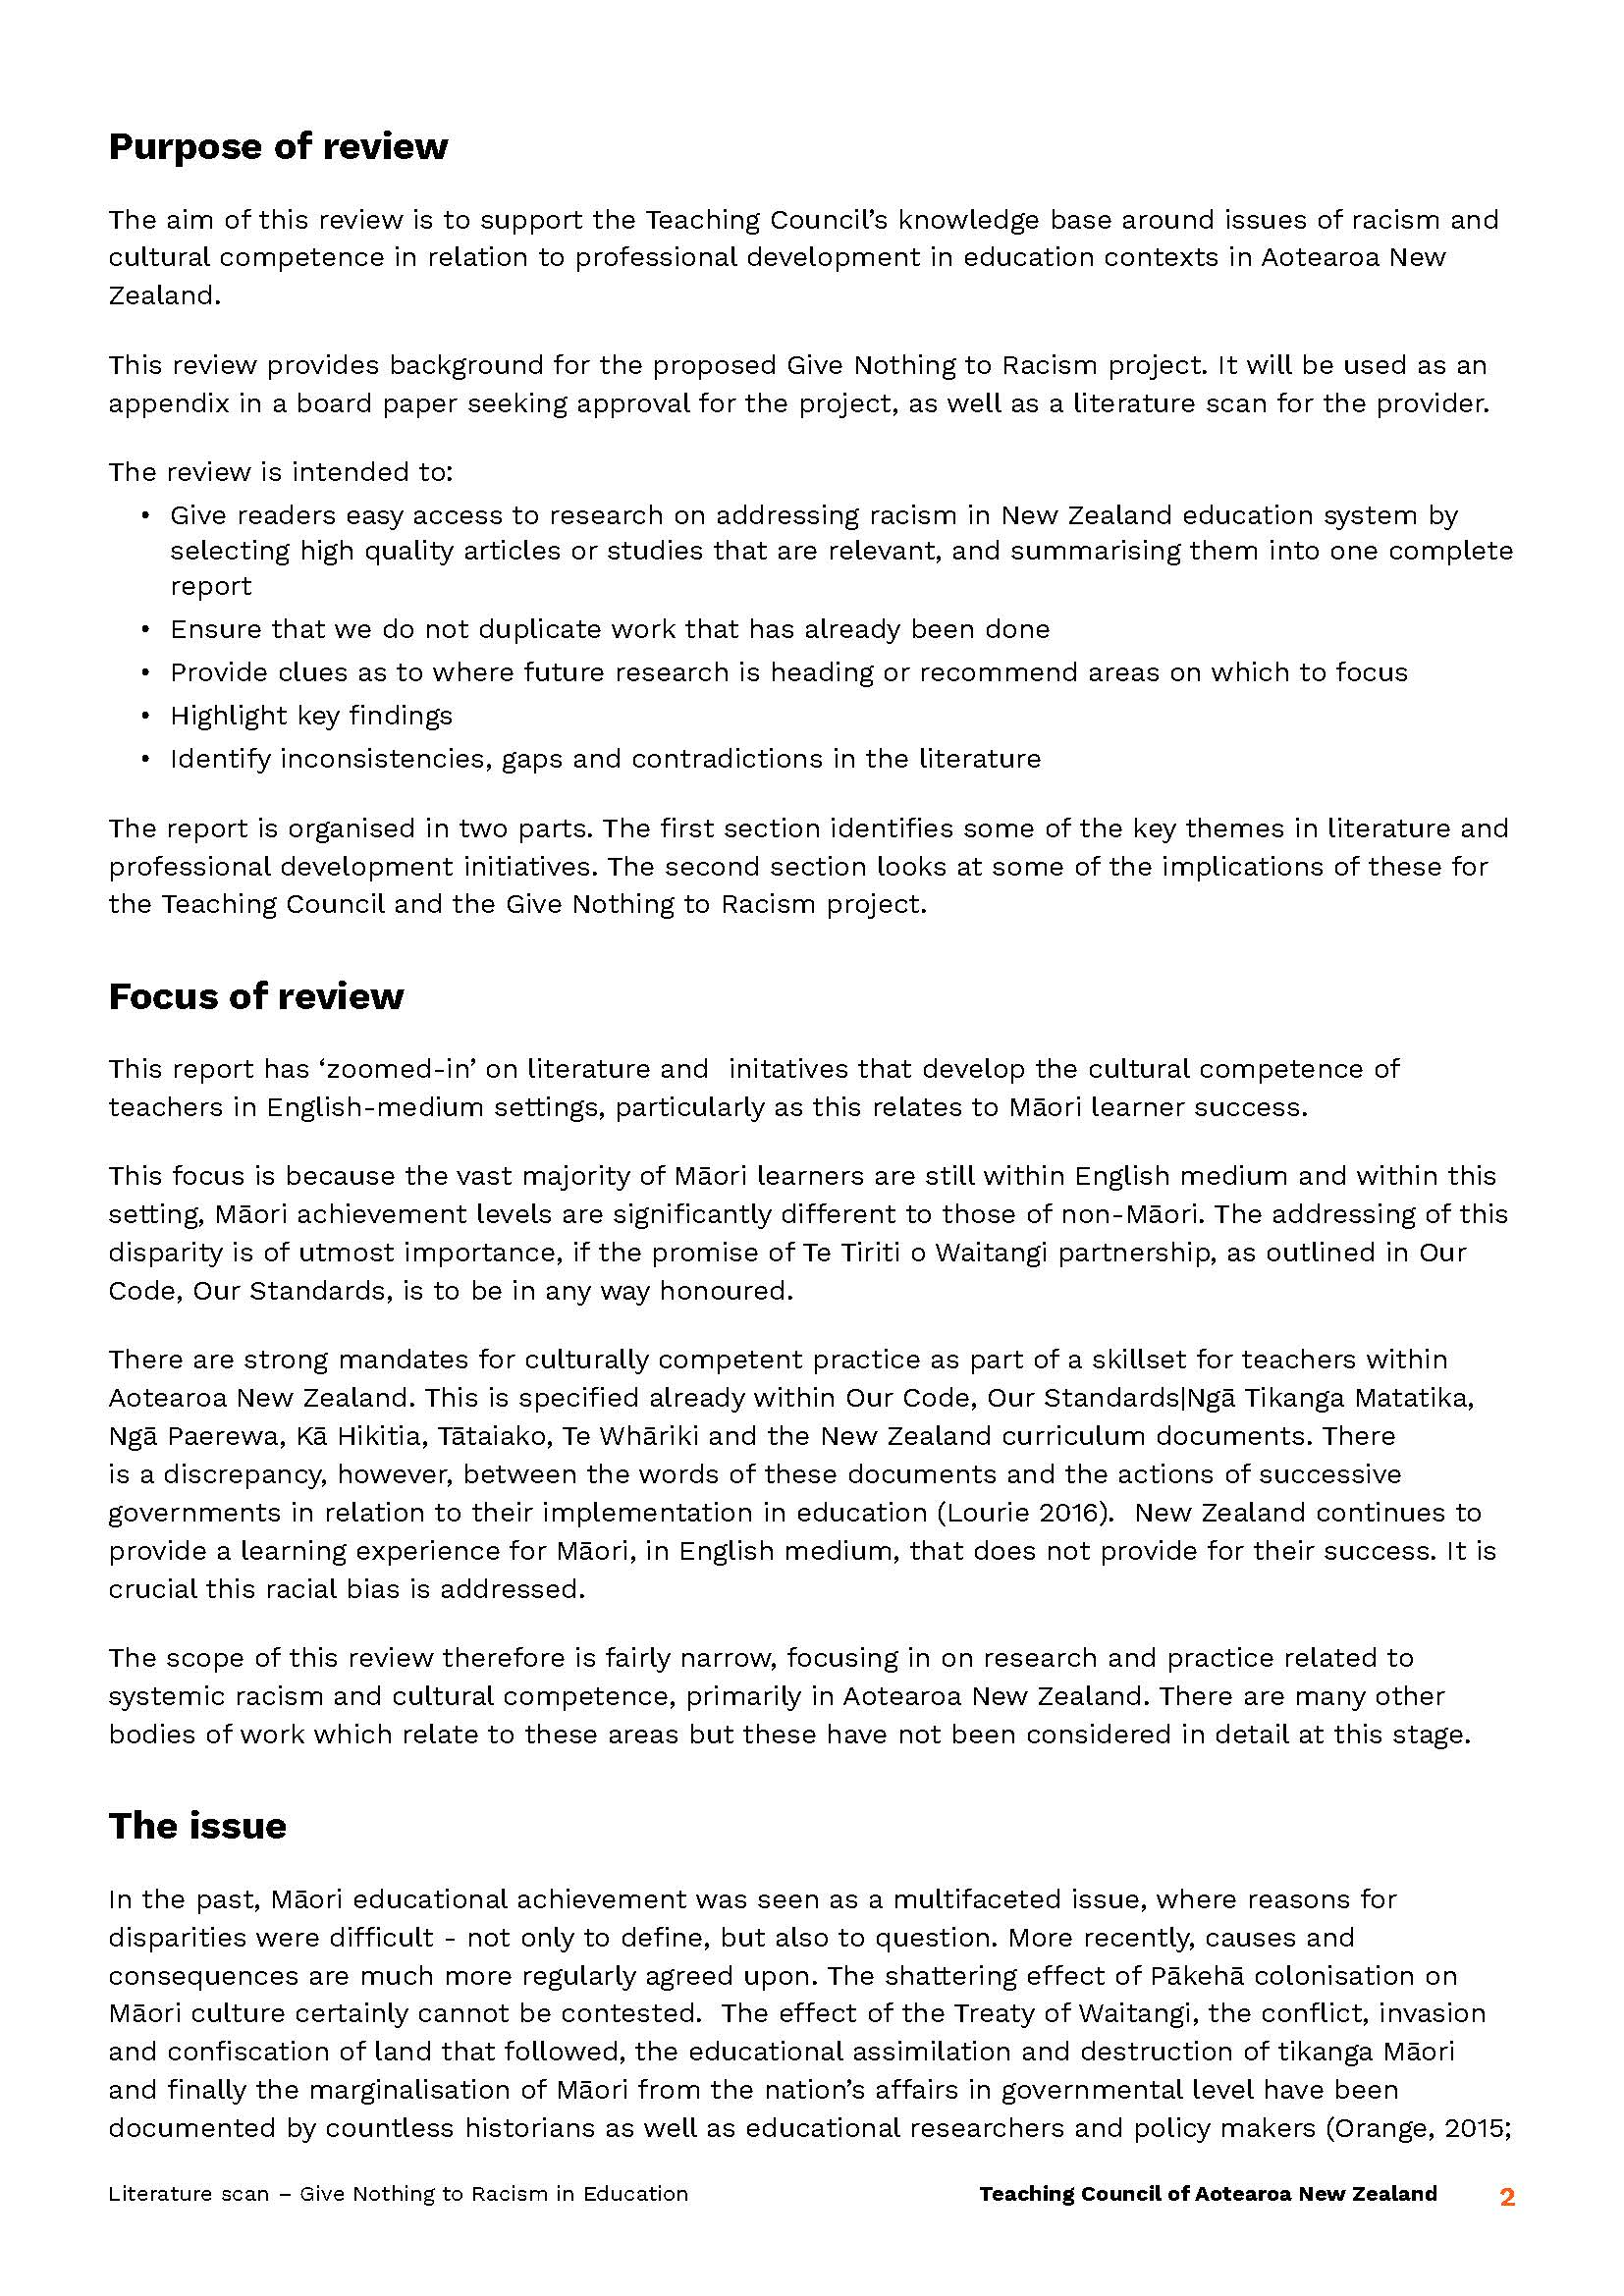
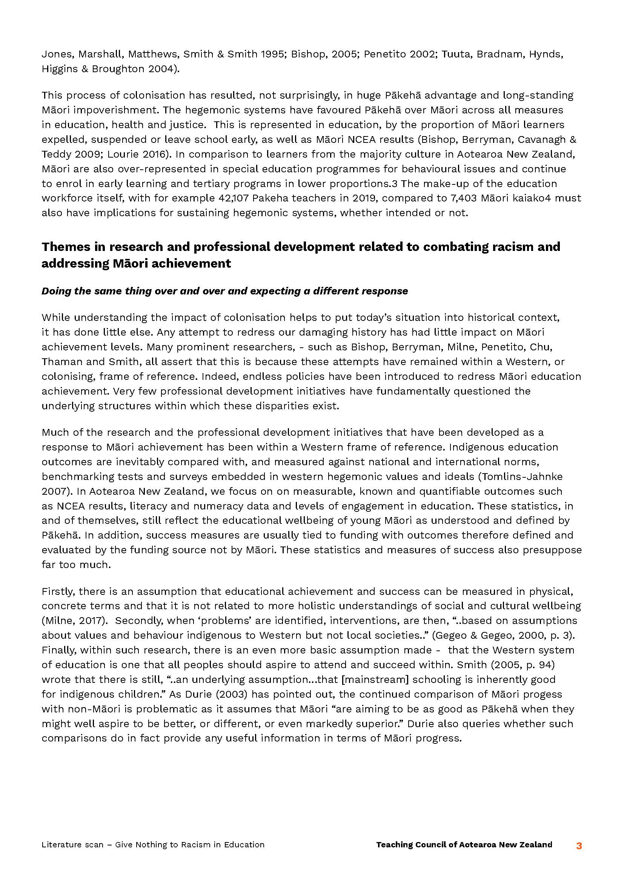
Website: Resources - Literature scan
Notes:
Our literature scan discusses the current research and professional development initiatives that informed Unteach Racism.

Slide 23
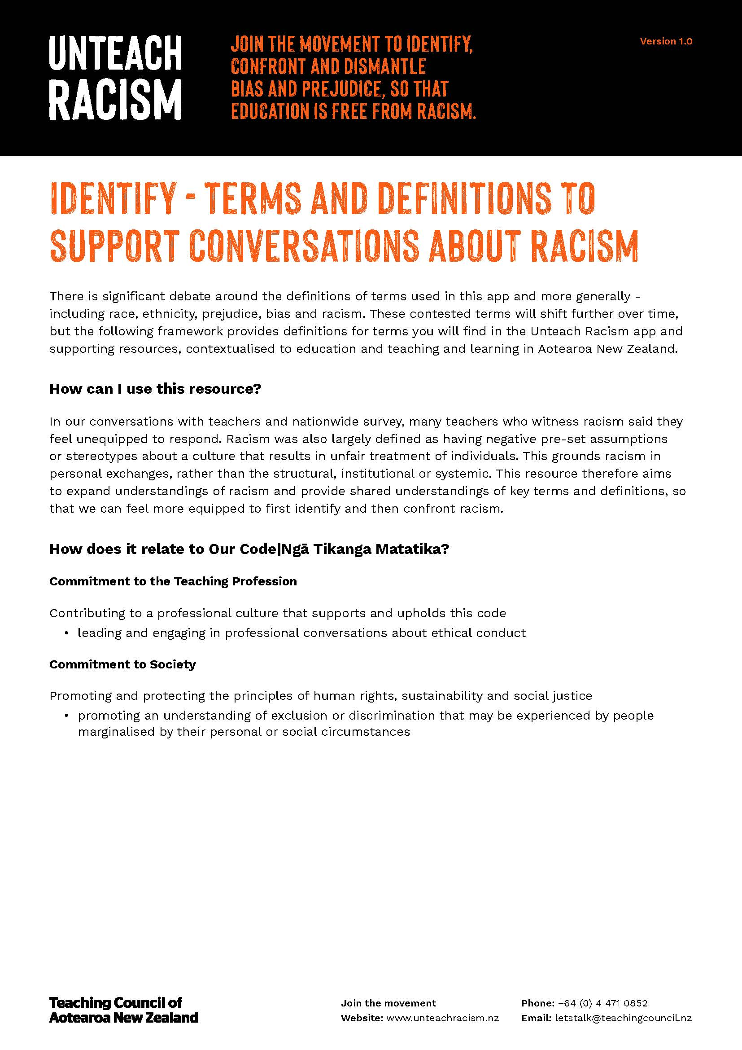
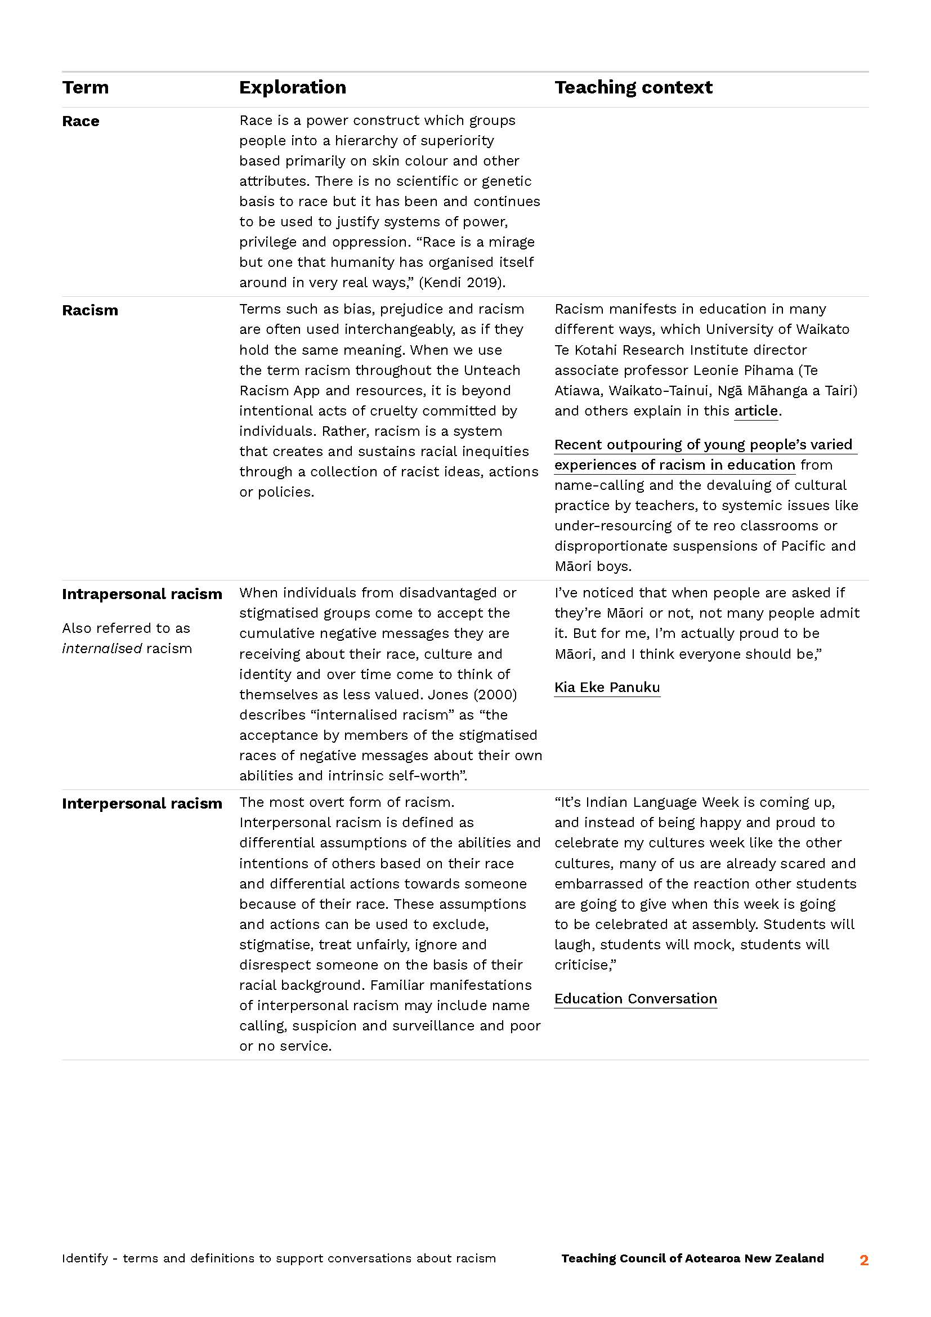
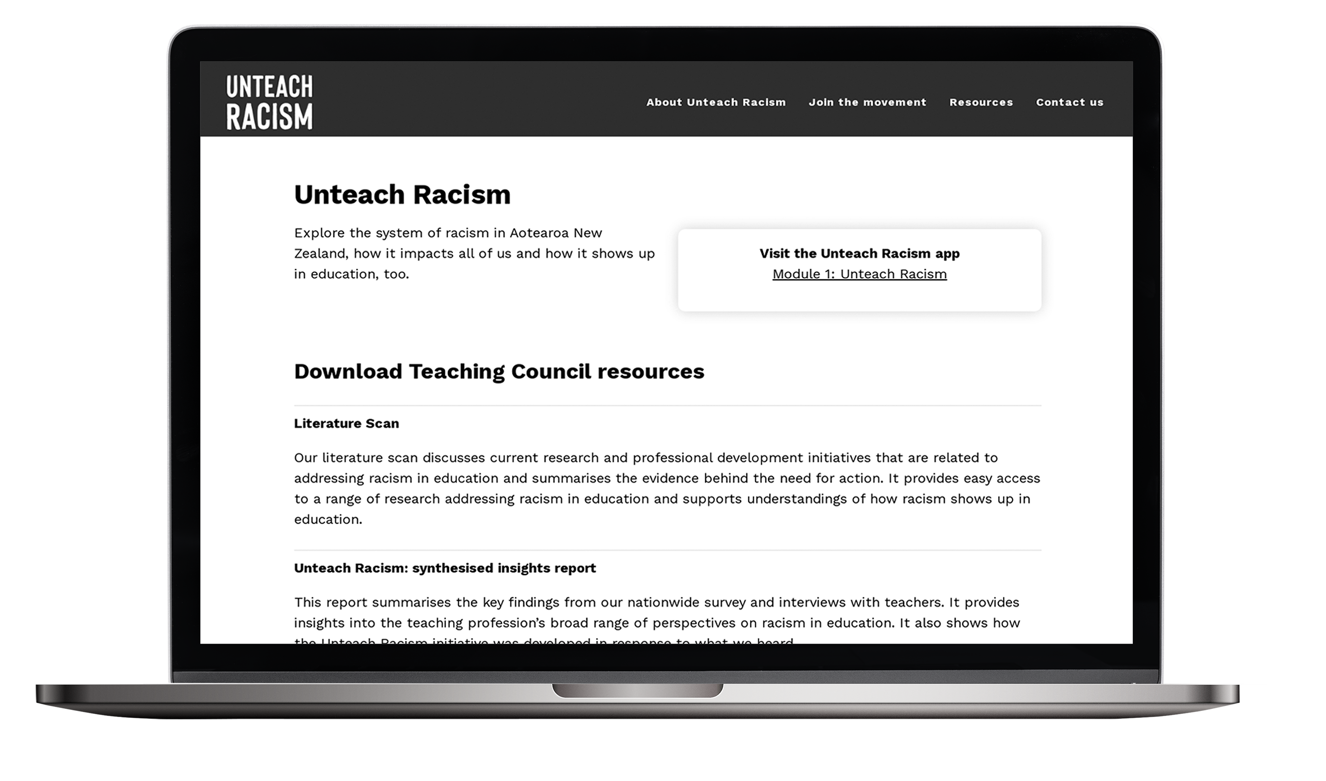
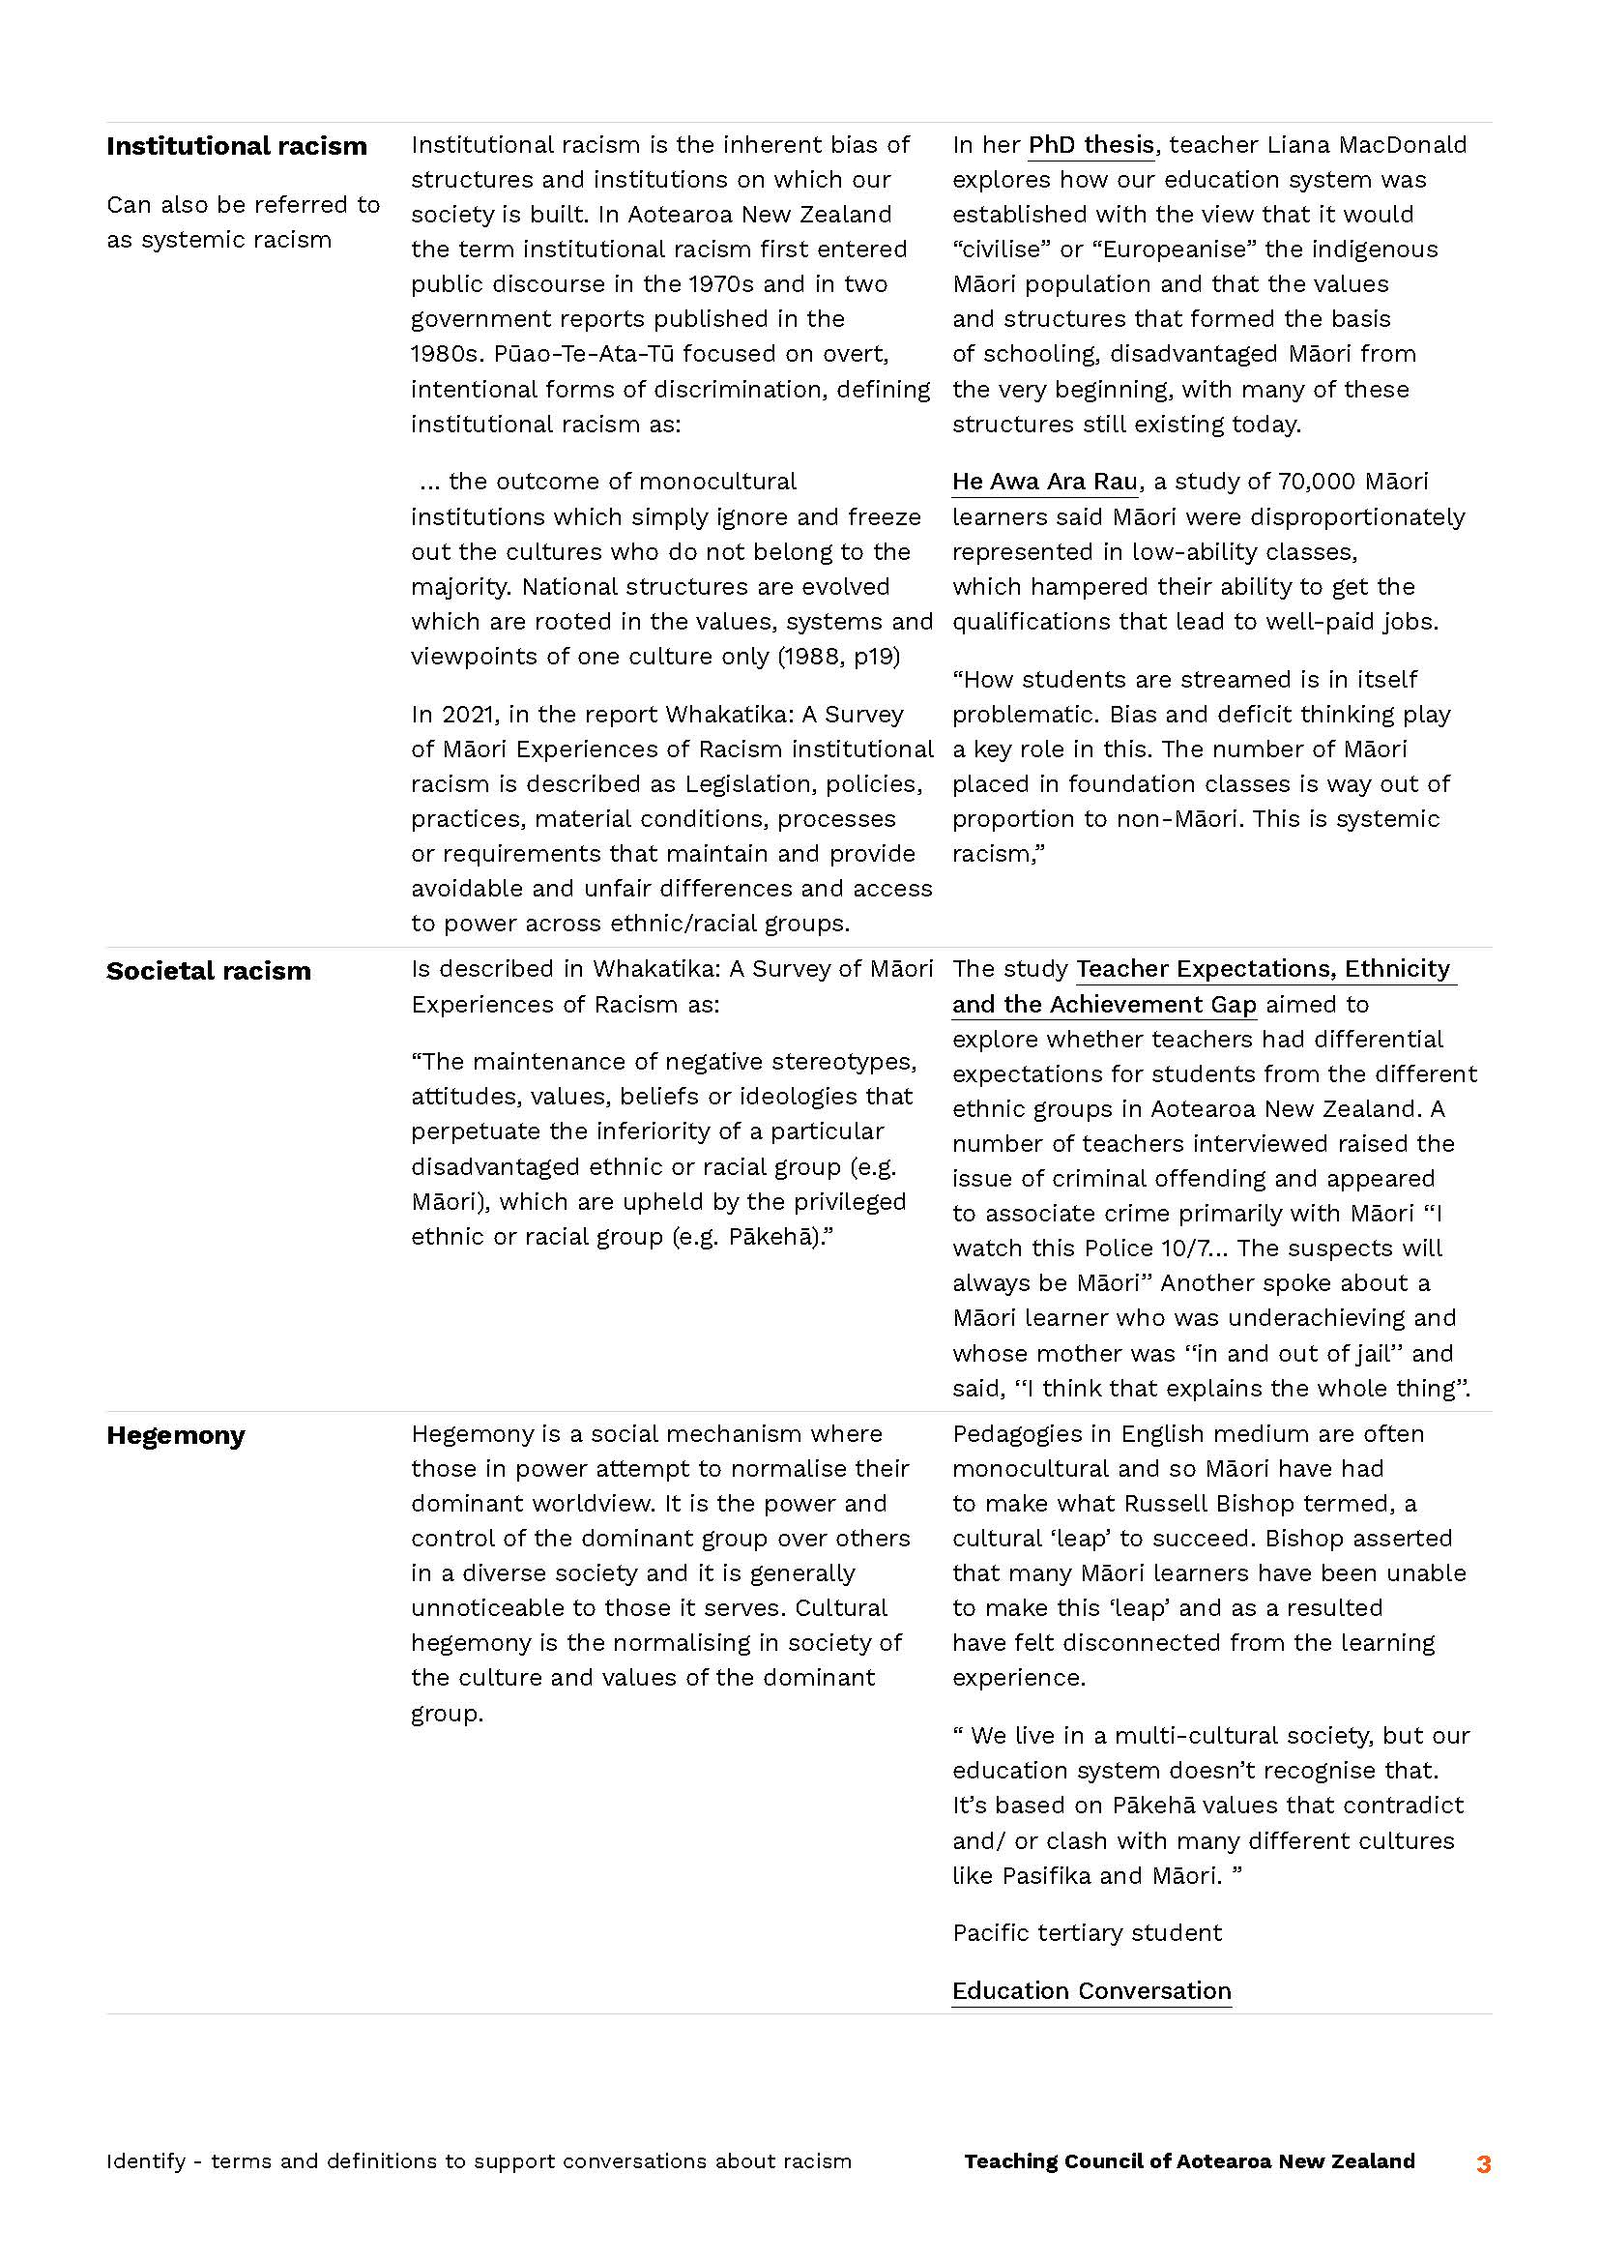
Website: Resources - Guides
Notes:
Several Guides provide practical, real-world support to teachers to first identify and then confront racism. These include auditing the texts you use and create, locating Unteach Racism in your Quality Practice Template, and a guide to safe and productive conversations about racism.

Slide 24
Join the Movement

Slide 25
​Unteach Racism toolkit
Share your story on social media with our toolkit.
#UnteachRacism
Notes:
The Unteach Racism toolkit is freely available to download from the website. You can link to this from ‘Join the Movement’ in the main menu or the ‘Unteach Racism toolkit’ link at the bottom of the website.
The posters are a great way of encouraging your colleagues to start their journey. You can also share your story on social media along with one of the digital graphics you’ll find in the toolkit. Don't forget to include the hashtag #UnteachRacism to increase the reach.

Slide 26
Let’s talk
The Teaching Council would love to hear from you on:
how you have engaged with the Unteach Racism resources and what changes this has meant for you
how you have applied what you have learnt through your practice, or
what you have already been doing in this space, and
how else we can help to support you on this journey.
Contact to share with us letstalk@teachingcouncil.nz
Notes:
We want to encourage your feedback on the ways the profession have engaged in the Unteach Racism resources and what changes this has meant. Also, how you have applied the learnings in practice, and what you are already doing in this space.
If you are interested in sharing your Unteach Racism story with the Teaching Council, please contact us via email ​letstalk@teachingcouncil.nz

Slide 27
Engage
We would also really appreciate your input on what we need to include in our next steps, especially as we build our resources around the next two stages to confront and dismantle racism.
Let us know what you need in the next stage of Unteach Racism.
Email: letstalk@teachingcouncil.nz
Notes:
We’d really appreciate your input on our next steps as we build our resources around confronting and dismantling racism.
Let us know what you need in the next stage of Unteach Racism.
Email: letstalk@teachingcouncil.nz

Slide 28
Call to action
Complete the app modules
Sign up for the quarterly newsletter on the Unteach Racism website
Engage in conversations on Hapori Matatū
Lead a discussion around one of the resources
Include Unteach Racism in your Professional Growth Cycle
Contribute to confront and dismantle phase.
Notes:
Unteach Racism is a call to action and a call to leadership. Your first steps may be to connect with the app or to sign up to the Unteach Racism quarterly newsletter for updates on when new resources, including the dismantle phase, become available.
You may like to lead discussions and share the app with colleagues or include unteach racism in your Professional Growth Cycle.
We know everyone will be at a different place in their journey, and that’s great, moving forward in action is the most important next step, and only you can determine what that may be.

Slide 29
He manga wai koia kia kore e whitikia?
Is it a river that cannot be crossed?
Notes:
He manga wai koia kia kore e whitikia?
Is it a river that cannot be crossed?

Slide 30
Notes:
Thank you for taking the time to enjoy our first webinar.
We hope this helps you and your setting to take the first step in the Unteach Racism journey.

